Slide 1

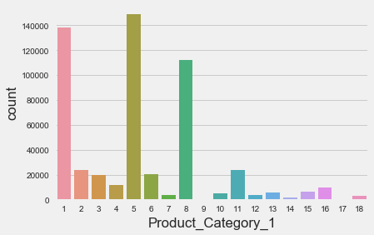
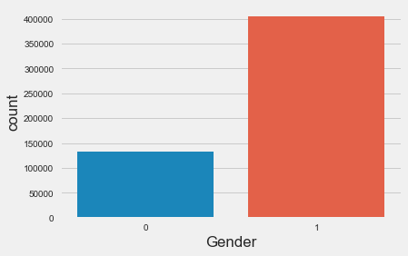
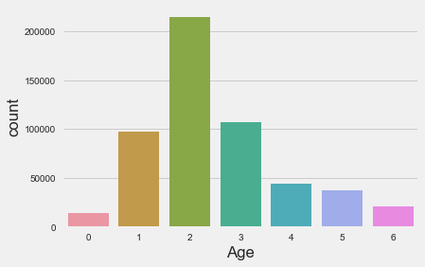
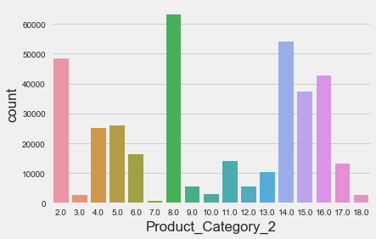
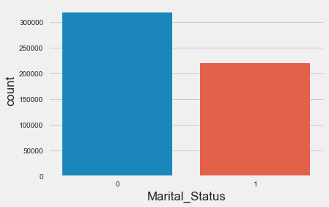
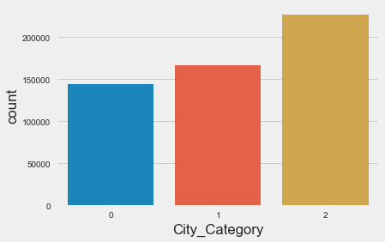
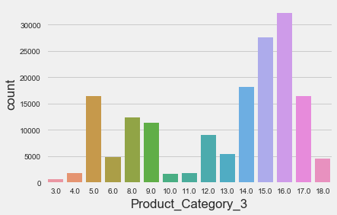
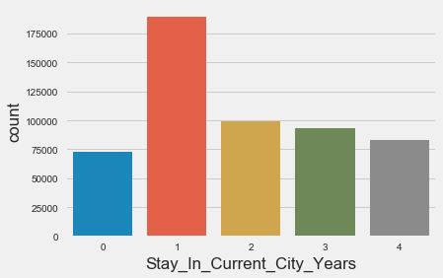
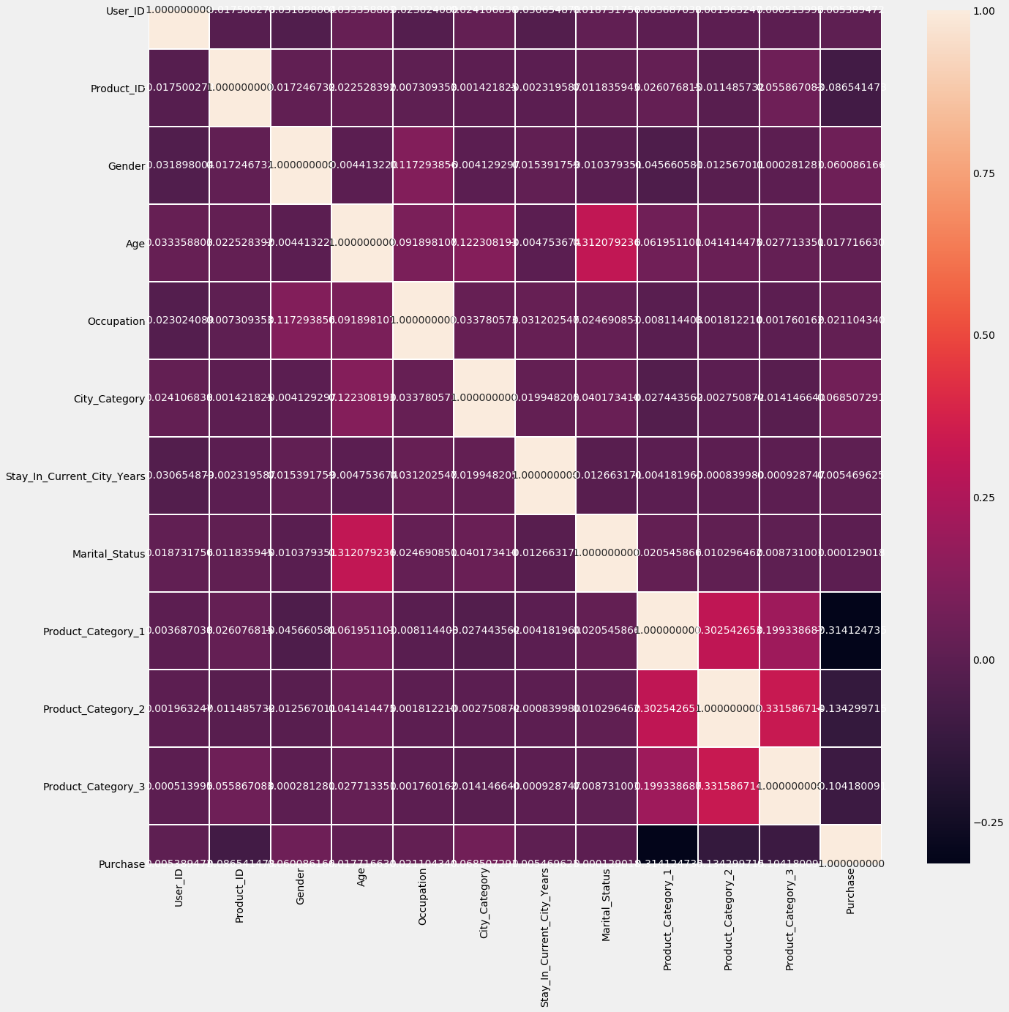
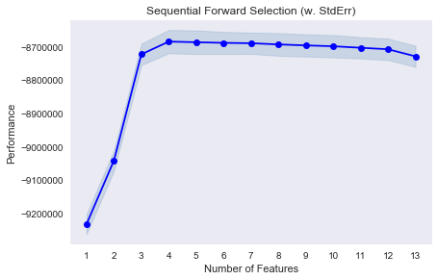
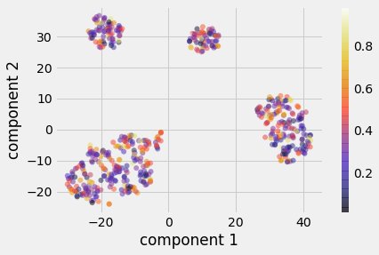
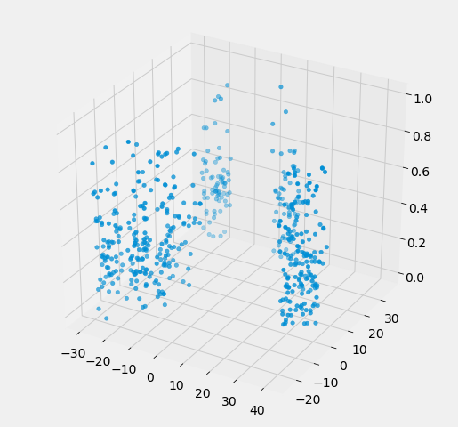
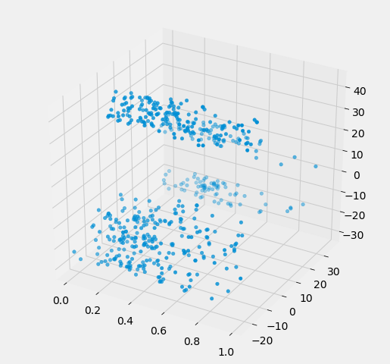
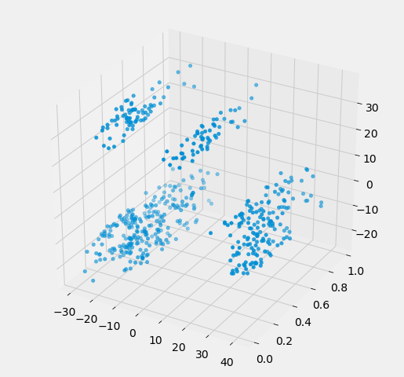
Black Friday: How much will a customer spend?
Sviatoslav Fedoriv
Introduction
1
Methodology
2
Perhaps one of the most obvious applications of Machine Learning in retail is predicting how much a customer is likely to spend at a store. Such predictor has a clear commercial value to the store owners as it would help with their financial planning. On kaggle it is provided a dataset on Black Friday customer purchasing patterns.
The methodology is pretty simple. First I first need to find such regression that will have
the least mean squared and mean absolute errors.
Before that I did missing values imputation for 1, 2 and 3 product category. For 2 product category
Experiment Setup
3
The experiment setup involves:
Take a quick look at the Data Structure
Data Pre-processing
Feature engineering
Selection of model
As you can see there is some dependence between product categories, it means that the biggest part of people would more like to buy one product, the second part two kinds of products and only a few would by all kinds.
Also as you can see the biggest part of costumers are single wimen. Second part is single men. And only then mearried people.
mod
і SequentialFeatureSelector
Selection feature
4 features are the most important.
'City_Category','Product_Category_1','Product_Category_2', 'Product_Category_3'
enough
enough
Correlation between Numerical Predictors and Target variable
Results
Conclusions
Lets see on our data pots using TSNE. I used 2d and 3d plots. As we can see on them samples can be easy segmented,It is look like RFR can be u used.
RFR gave us the
5
Applied Sciences Faculty, Ukrainian Catholic University, Lviv, Ukraine (fedoriv@ucu.edu.ua)

Slide 2
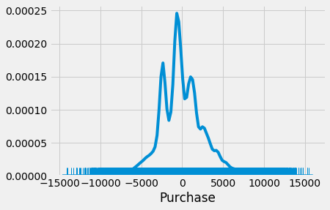
Black Friday: How much will a customer spend?
Sviatoslav Fedoriv
Result
1
Methodology
2
mean_squared_error on train : 0.012171099833985791
mean_squared_error on test : 0.015682259260149684
mean_absolute_error on train : 0.08422313974883826
mean_absolute_error on test : 0.09300154221881753
Conclusions
3
1)For missing value imputation random forest classifier works better then most frequent method.
2)We cant use most frequent method because we have more then 68% of missing value in product category 3 that
has the strangers correlation on target value.
3) RFR is the best model even beret than MLPRegressor.
4) These model beater to use to predict sum of day income of BF, because it steal have bet accuracy on one
sample.
Results
Conclusions
і
5
Applied Sciences Faculty, Ukrainian Catholic University, Lviv, Ukraine (fedoriv@ucu.edu.ua)

